Slide 1



Slide 2





BUDT 704 Team Project
Team Members
Akshay
Ganesh
Harish
Sumanth
Srishti

Slide 3

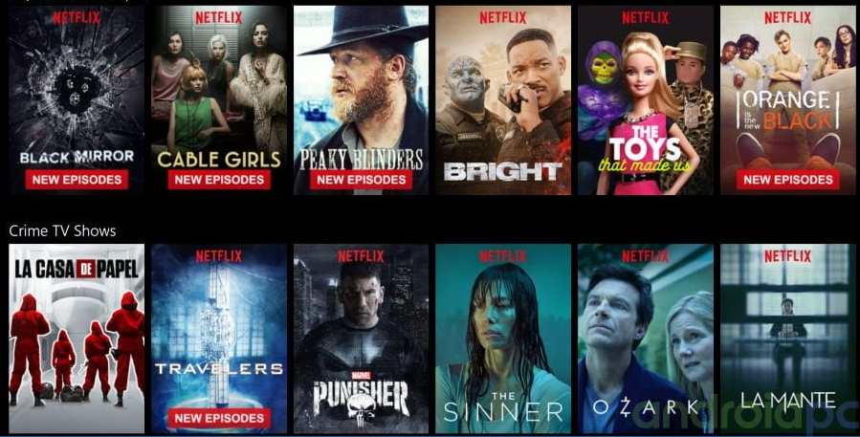
4
Dataset Introduction
60% for you
UA
2023
Welcome to our exploration of the vast world of Netflix data! In today's presentation, we will embark on a journey through an extensive dataset that encapsulates the diverse landscape of movies and series available on the streaming platform.
Objective
Our goal is to unravel key insights from the Netflix dataset, shedding light on trends, viewer preferences, and the impact of various factors on the content. By the end, we aim to provide a comprehensive understanding of what makes a title stand out in the Netflix universe.

Slide 4
Dataset Overview
The Dataset we chose was from Kaggle which provided the following key information such as the genre, category classification, Language and Region Availability, Run time, Cast, Rating metrics, box office and award related details.
Before we dive into the analysis, we recognize the critical role of data cleaning. Ensuring the accuracy and reliability of our findings is paramount, and we'll be addressing data inconsistencies, outliers, and missing values to present a polished and trustworthy analysis.
Overview of data clean-up process:
Duplicate Removal
Missing Values Handling for Categorical Columns
Filled missing values in categorical columns ('Genre', 'Languages', 'Director', 'Actors', 'Country Availability', 'Production House', 'Runtime') with 'Unknown'.
Missing Values Handling for Numerical Columns:
Filled missing values in numerical columns ('Hidden Gem Score', 'View Rating', 'IMDb Score', 'Rotten Tomatoes Score', 'Metacritic Score', 'IMDb Votes') with an empty string.
Dropped unnecessary columns ('Netflix Link', 'IMDb Link', 'Tags', 'Writer', 'Summary', 'Image', 'Poster', 'TMDb Trailer', 'Trailer Site').
Date Columns Processing
Awards Handling
Box-office Handling
Runtime Handling

Slide 5
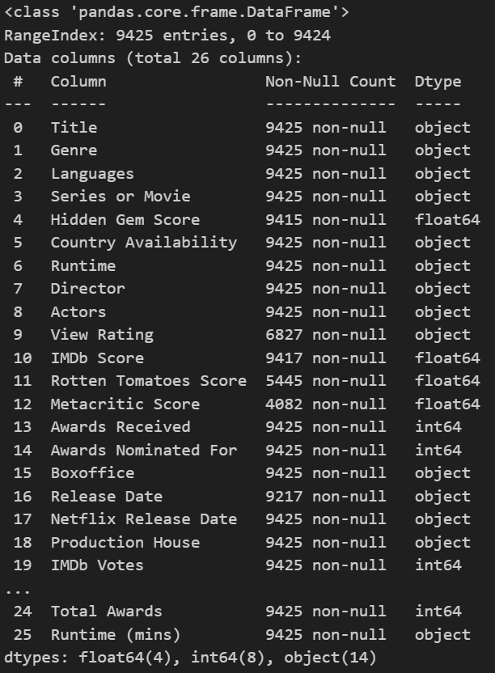
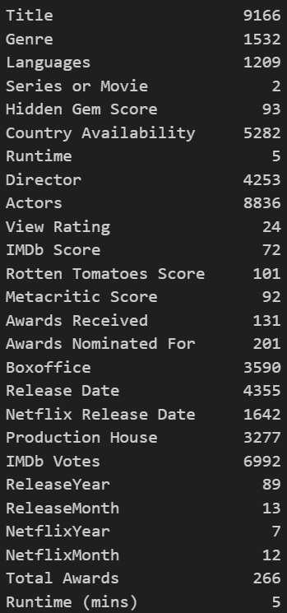
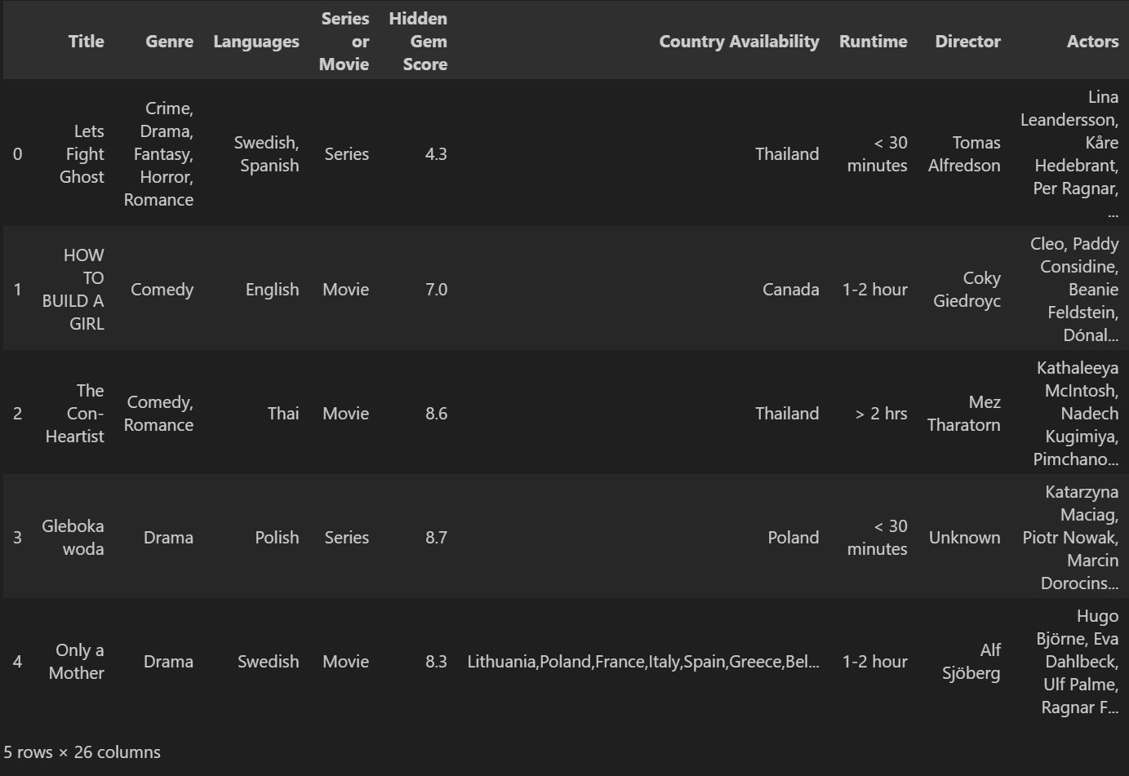
Data Exploration
df.info
df.nunique()
df.head(5)

Slide 6
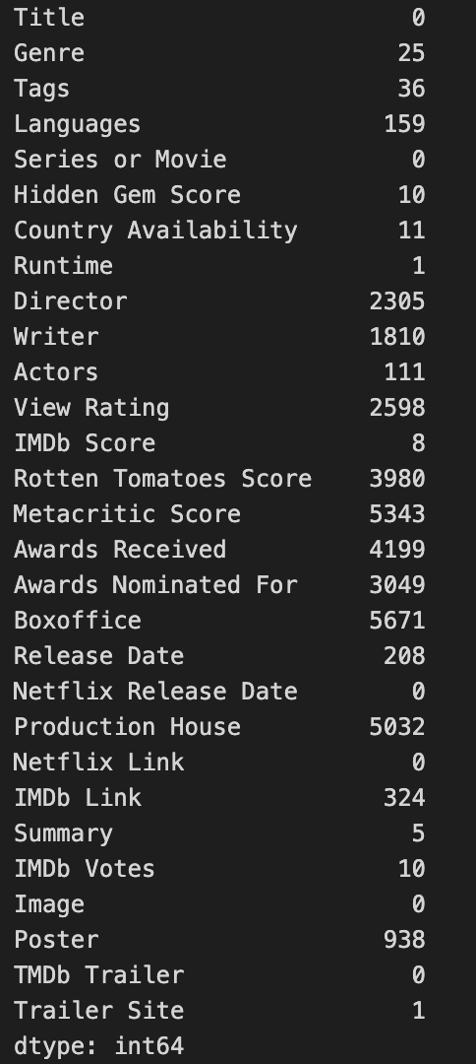
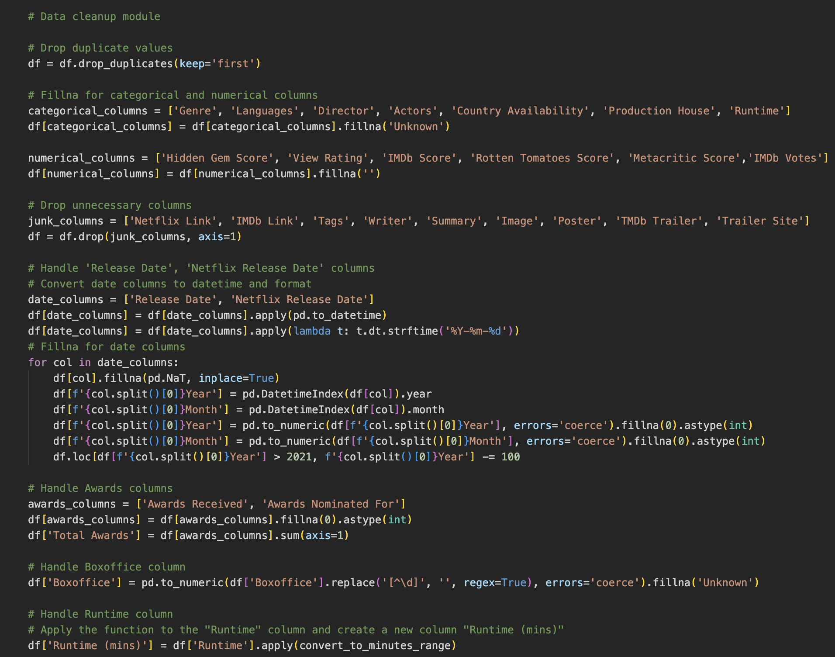
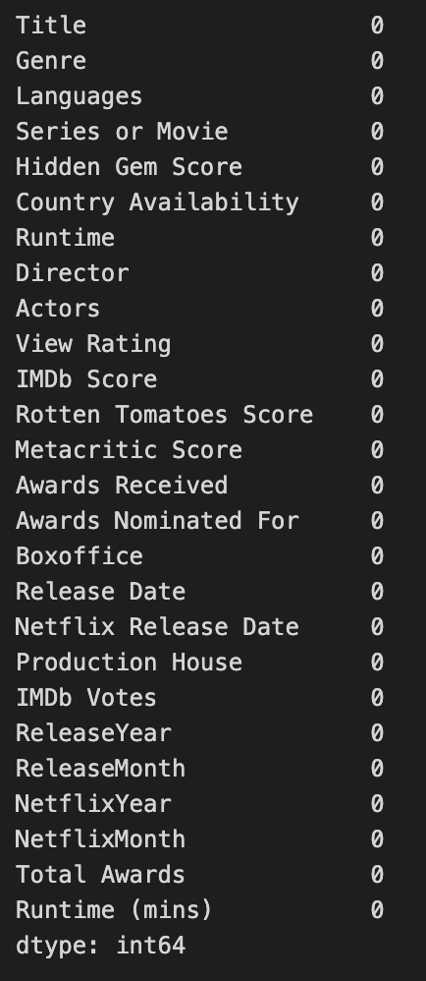
Pre-cleanup
Post clean-up
df.isnull().sum()
Data Clean-up
df.isnull().sum()

Slide 7
4
Stats and Trends
70% for you
16+
2023

Slide 8
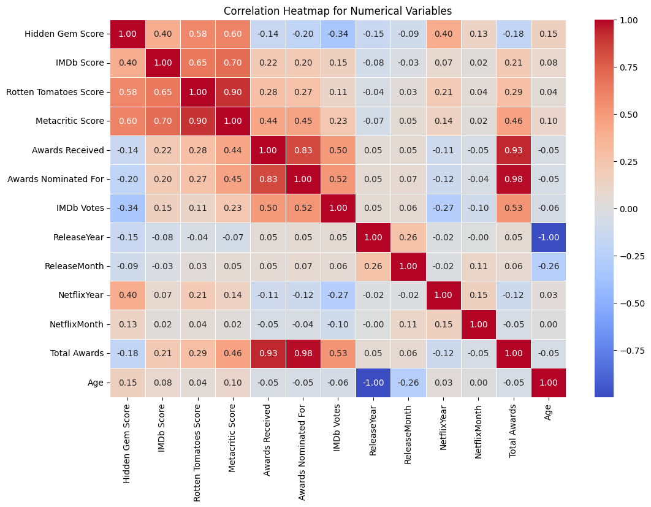
Correlation Matrix
The resulting heatmap provides a visual representation of how strongly or weakly numerical variables in the dataset are correlated.
The color intensity and the numerical values help interpret the direction (positive or negative) and strength of the correlations.
The heatmap is a valuable tool for identifying patterns and dependencies among numerical features in the dataset.

Slide 9
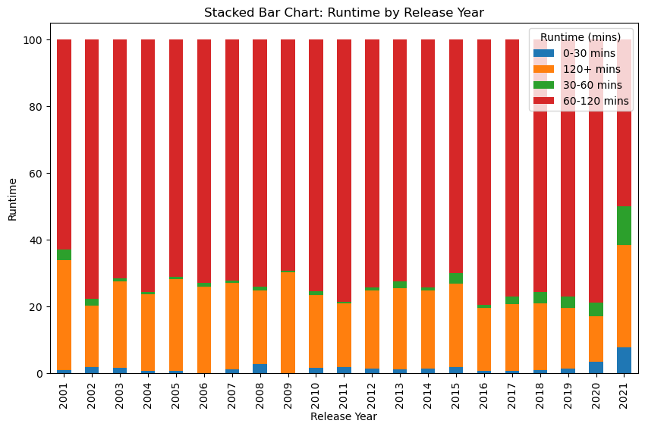
Runtime Analysis
As the movie release date in the dataset goes back to 1920’s we take the movies only after 2000 to understand the movie watchers' pattern and the strategy of movie/tv series acquisition employed by Netflix when it comes to Run times
Notes:
In our analysis of movie runtimes on Netflix, we focus on titles released after the year 2000 to glean insights into contemporary movie-watching patterns. The decision to narrow our scope reflects a strategic choice aimed at capturing more relevant and recent trends in viewer preferences. By excluding titles from the early 20th century, we aim to better understand Netflix's acquisition strategies for both movies and TV series and discern patterns in runtime preferences that align with modern audience behaviors. This focused approach enhances the relevance of our findings, providing a nuanced perspective on how Netflix curates and presents content to its audience

Slide 10
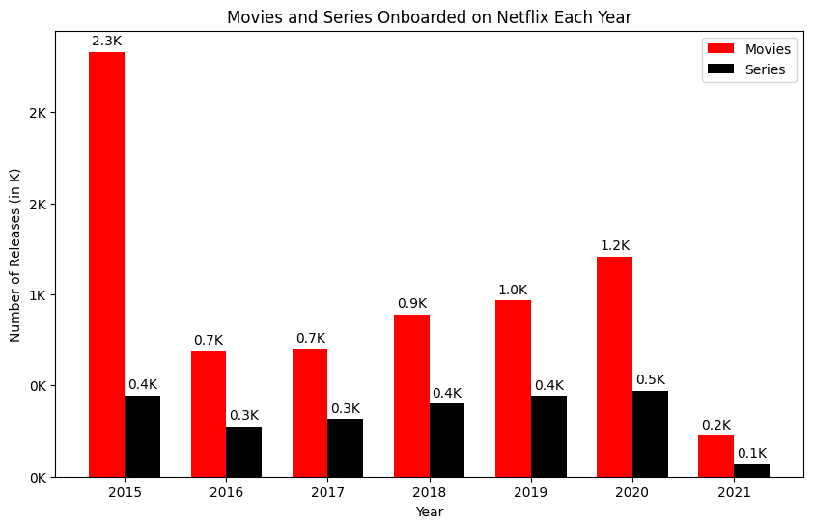
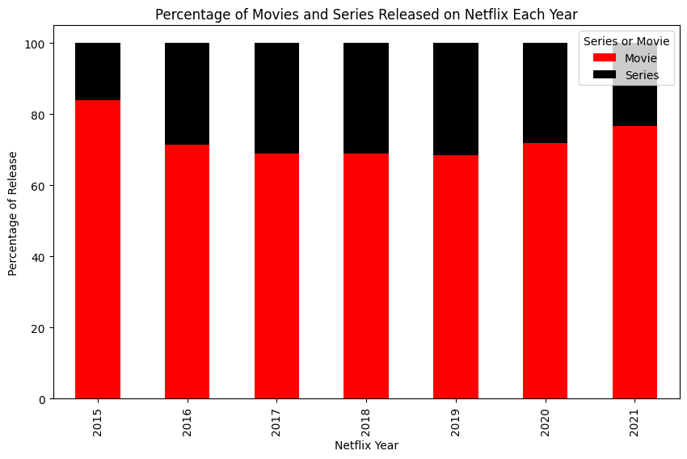
Content Type Analysis
We analyze the trend of the percentage mix of movies and series released on Netflix over the years and aims to provide insights into Netflix's acquisition strategy.
Excluding 2015(Netflix boom) and 2021 (Data till April) we can see that the content acquisition has peaked in 2020 (COVID boom) in both the series and movies category.
Although the increase is gradual in the series category, and this could be attributed to the content availability in the market as opposed to movies.
Notes:
Our goal is to analyze the percentage mix of movies and series released on Netflix over the years, with a particular focus on understanding Netflix's content acquisition strategy. Mention about the 70 30 split. Before we dive into the trends, it's important to note that we've excluded the years 2015 and 2021 from our analysis.""2015 marks a significant milestone in Netflix's growth, often referred to as the 'Netflix boom,' which might distort our trend analysis.""For 2021, our data is only available until April, providing a snapshot of the year rather than a complete picture.“ the peak in content acquisition occurred in 2020 for both movies and series could be attributed to COVID and as a part of user acquisition strategy, Netflix has added additional titles. Interestingly, while the increase in content acquisition is gradual in the series category, it's substantial.""This gradual rise prompts us to consider factors beyond strategic decisions, such as the availability of compelling series content in the broader market.

Slide 11
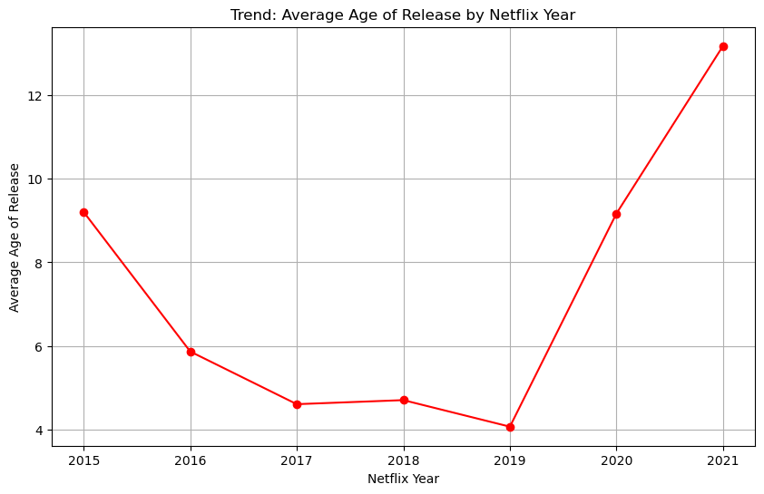
Average Age of Content onboarded
We created a new column called Age which is difference of the Netflix Release Year and the Movie Release Date.
Similar to the previous slide where we exclude 2015 and 2021 for analysis purpose. We can observe that the when COVID hit Netflix went on a purchase spree which would help with user acquisition along with producing NETFLIX only shows and films.
Notes:
Our analysis delves into the temporal dimension of Netflix's content acquisition strategy by introducing a new metric – 'Age,' representing the difference between the Netflix Release Year and the Movie Release Date. Similar to the previous slide where we exclude 2015 and 2021 for analysis purpose.
The data suggests that Netflix went on a notable purchase spree during the COVID-19 period. The content acquisition surge during COVID points towards a deliberate strategy to capitalize on the unique circumstances of the time.By offering a diverse and extensive library, Netflix aimed not only to retain existing subscribers but also to attract new users seeking fresh and engaging content.
As the effects of the pandemic evolved, Netflix continued to leverage its extensive library and exclusive content to maintain and grow its user base. "The observed purchase spree during COVID underscores Netflix's adaptability and agility in responding to external events.

Slide 12
4
Popularity Metrics
80% for you
16+
2023

Slide 13
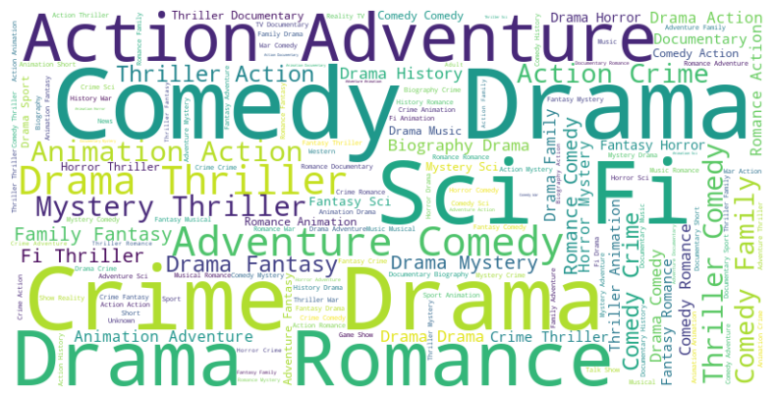
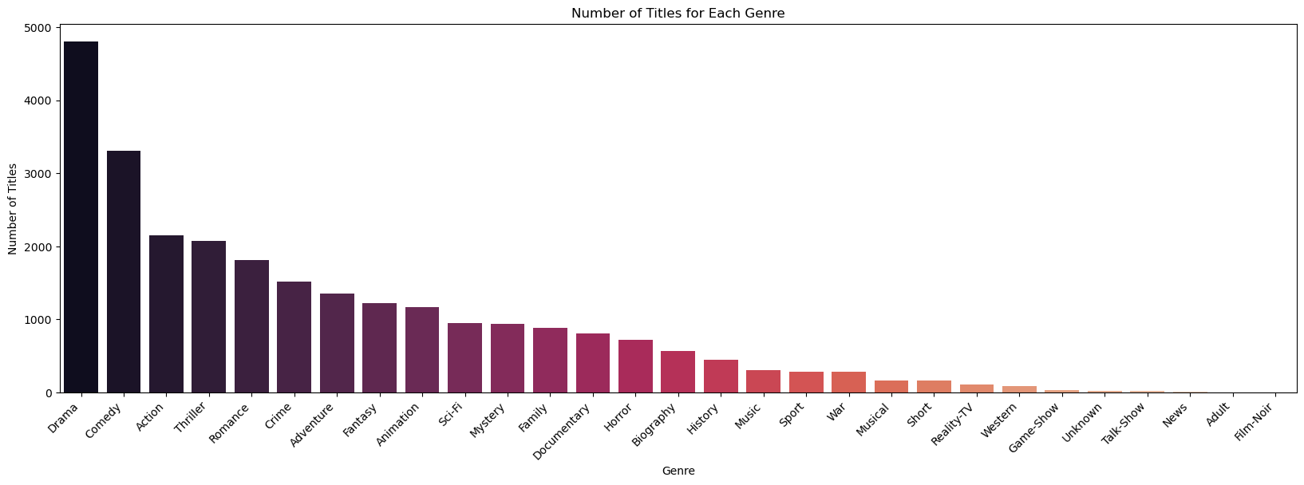
Popular Genres
Genres play a crucial role in shaping user preferences and streaming behavior, making this exploration significant for understanding viewer choices.
It's interesting to note that genre preferences may vary across years.
The popularity of certain genres directly influences Netflix's content acquisition strategy

Slide 14
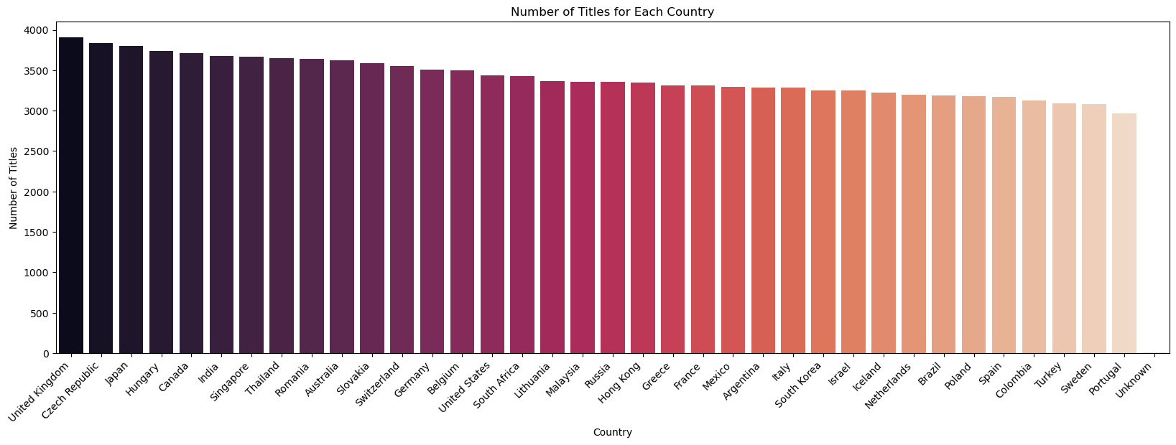
Titles available per country
Understanding regional content offerings is vital for appreciating Netflix's global strategy and its commitment to tailoring content to local audiences.
Our analysis pinpoints the countries that enjoy a rich selection of titles, reflecting Netflix's investment in diverse content offerings.
It's fascinating to observe how the number of titles varies from country to country. This variation may be influenced by factors such as licensing agreements, regional preferences, and Netflix's strategic decisions.

Slide 15
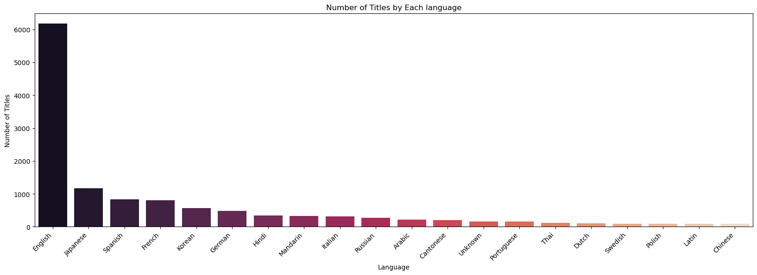
Title availability per language
Our analysis draws insights from the Netflix dataset, focusing on the distribution of titles across various languages
Our analysis reveals that English leads the pack with over 6000 titles, followed by Japanese at 1100.
Netflix employs localization strategies to cater to linguistic preferences.
By offering content in multiple languages, Netflix ensures that users worldwide can access and enjoy content in their preferred language.

Slide 16
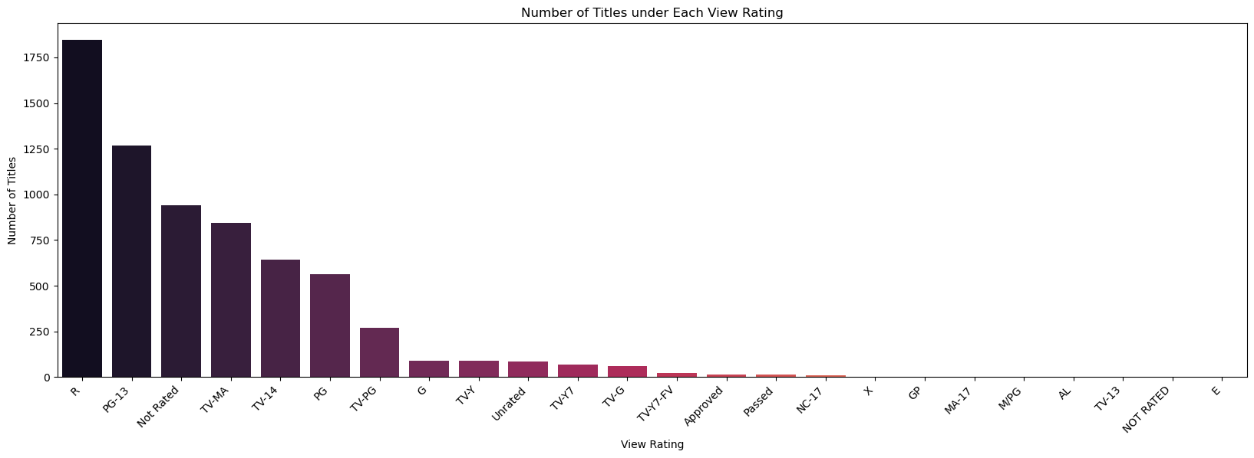
Titles by Content Rating
This provides an insight into the varied content landscape, encompassing titles suitable for diverse audience preferences.
Owing to different rating scales across different countries we can see that the graph has lot of columns as opposed to a few rating categories.
R rating.
This genre often includes intense themes, complex storylines, and content tailored for a more mature viewership.
Netflix's data-driven approach and understanding of viewer preferences contribute to the platform's curated selection of mature content.

Slide 17
4
Crème de la crème
85% for you
16+
2023

Slide 18
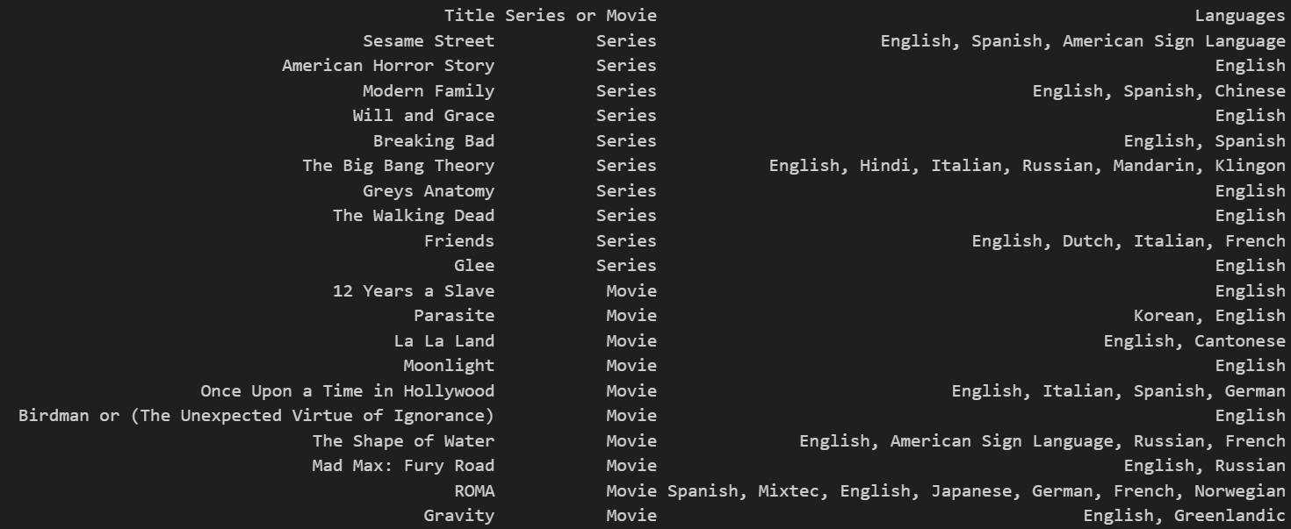
Top Series and Movies Based on Awards

Slide 19
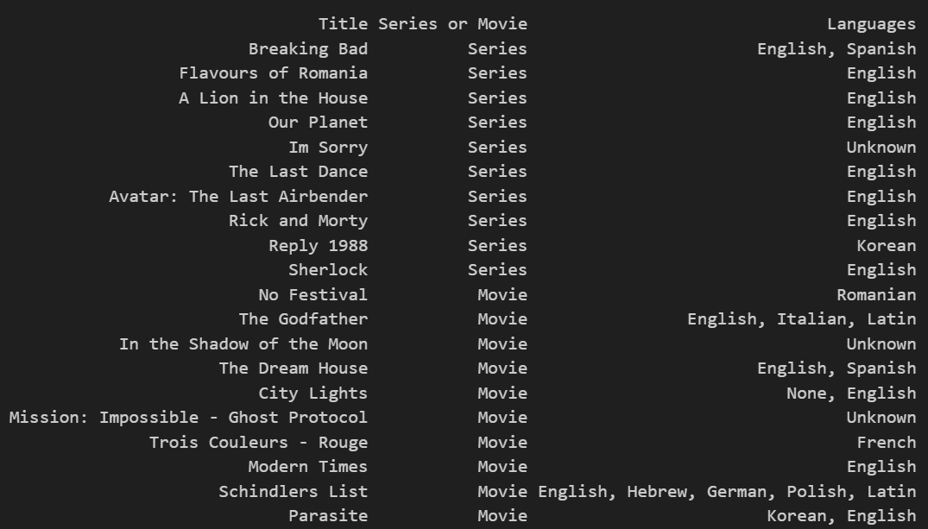
Top Series and Movies based on Ratings

Slide 20
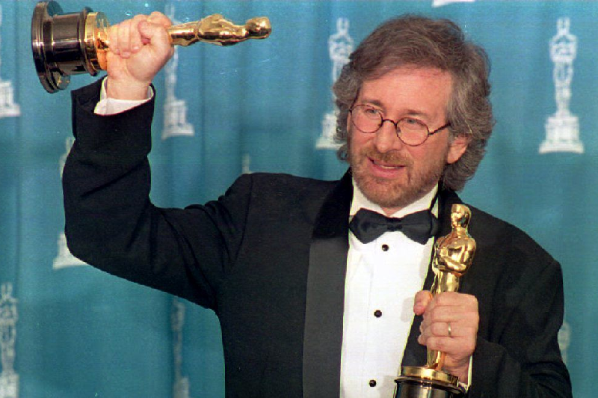

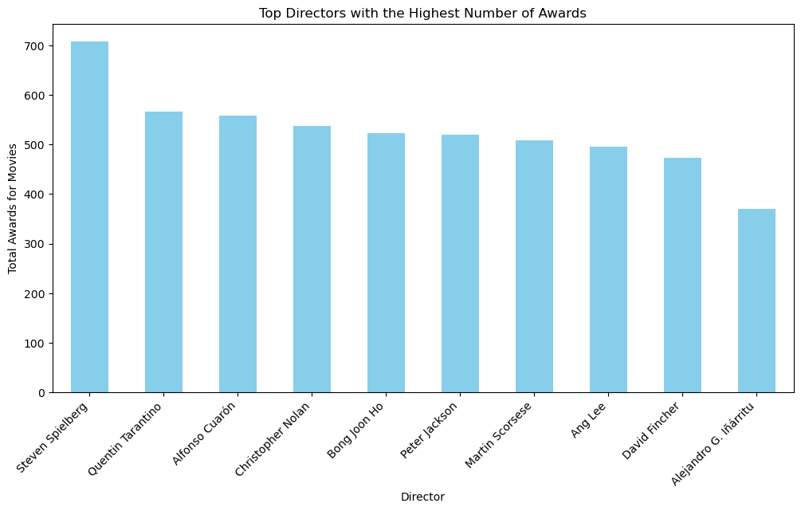


Top Directors with the highest number of Awards and Nominations

Slide 21
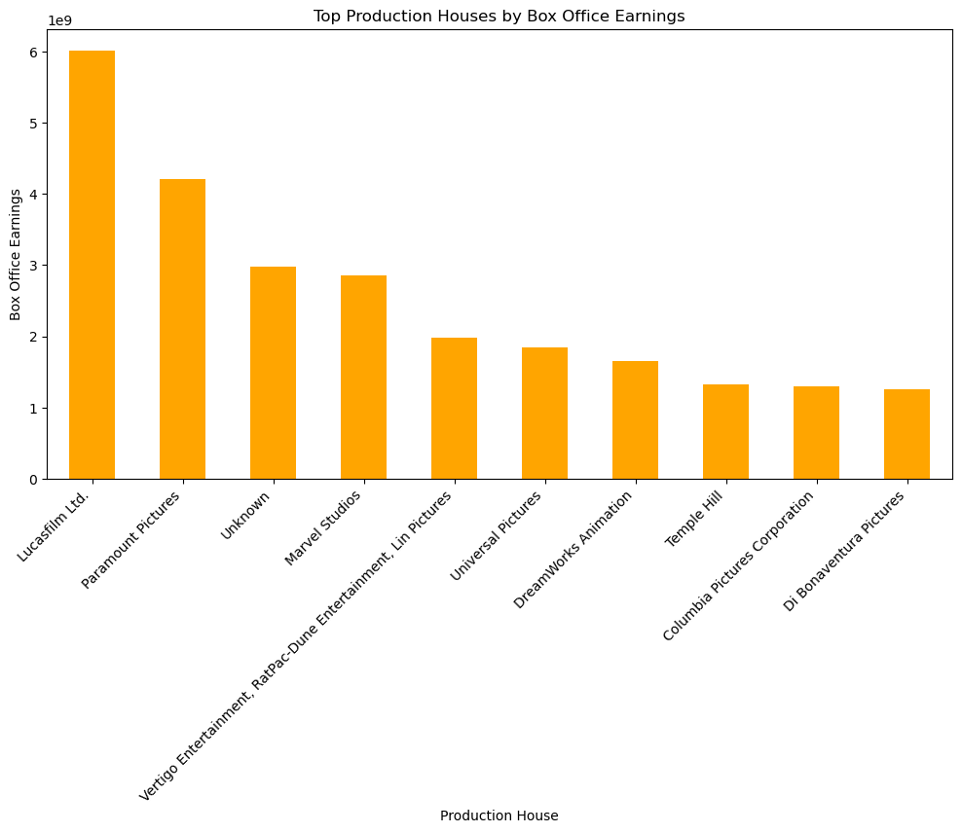
Top Production House based on Box office earnings

Slide 22
4
Your Content for the winter break
Definitely for you
16+
2023

Slide 23
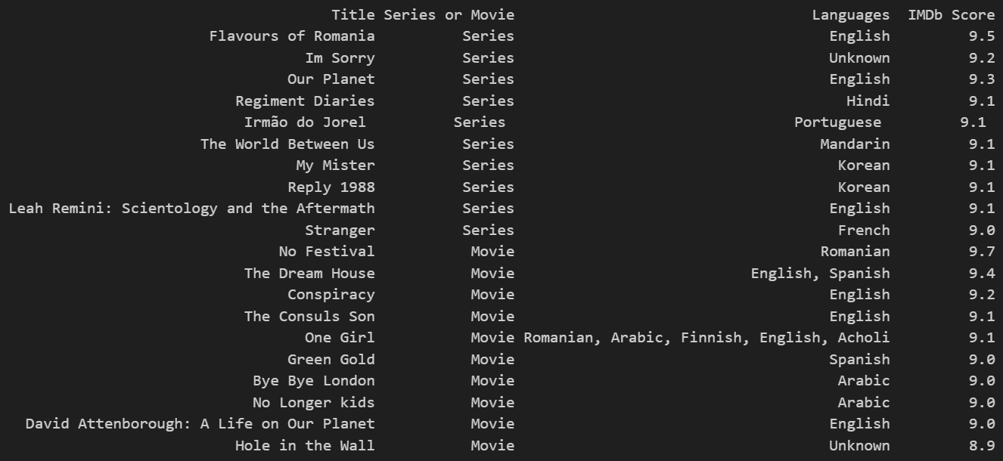
Calculation of our Recommendation Score
We try to compute a metric where we look for hidden gems.
Hidden gems are those films or series with high rating and low user reviews.
To ensure a fair comparison, we've normalized the number of IMDb votes on a scale of 1 to 10, setting the stage for a comprehensive recommendation metric.

Slide 24
